Slide 1


Expanding AI Innovation in Pervasive Systems at Arizona State University
Hassan Ghasemzadeh, Associate Professor
College of Health Solutions
Biomedical Informatics, Computer Science, Computer Engineering, Biomedical Engineering
Director, Embedded Machine Intelligence Lab
Arizona State University
Pavan Turaga, Director and Professor
School of Arts Media and Engineering
Health Solutions Ambassador
Herberger Institute for Design and the Arts
School of Electrical, Computer and Energy Engineering
Arizona State University
University of Texas Austin – May 30, 2024

Slide 2
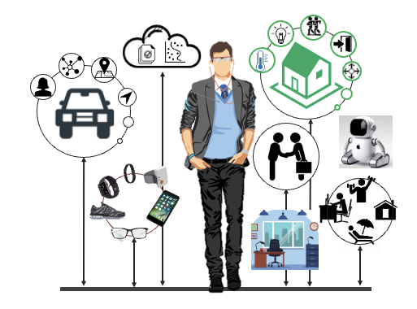
Pervasive Systems
Integrate computing capabilities into everyday objects such as phones, wearables, cars, assistive robots, homes, workplaces, etc.
Common attributes
Highly dynamic environments
Direct interaction with humans
Constrained in resources
Need for robust, interactive, and embedded pervasive systems
Focus of this ExplandAI project

Slide 3
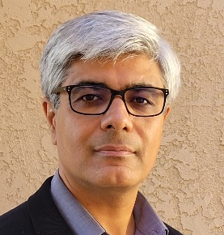
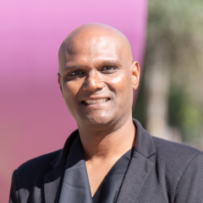
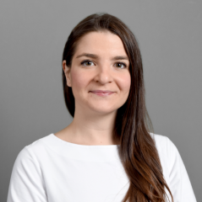
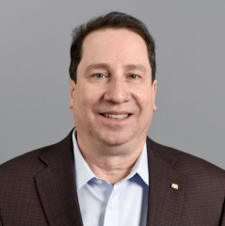


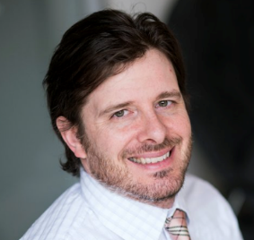
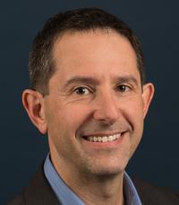
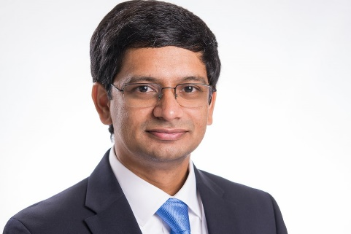

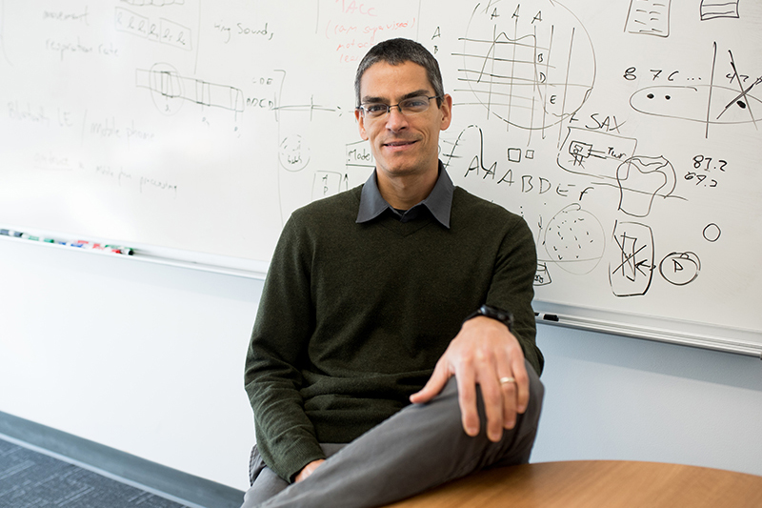

Team and Projects
Hassan Ghasemzadeh
Biomedical Informatics
Pavan Turaga
Electrical Engineering
Giulia Pedrielli
Computer Science
Daniel Rivera
Chemical Engineering
Adam Klivans
Computer Science
Peter Stone
Computer Science
Joydeep Biswas
Computer Science
Amy Zhang
Computer Science
Edison Thomaz
Computer Eng.
Brad Knox
Computer Science
Project themes
Aligned reinforcement learning for behavior change
Pervasive continual learning
Robust robot perception and decision-making

Slide 4
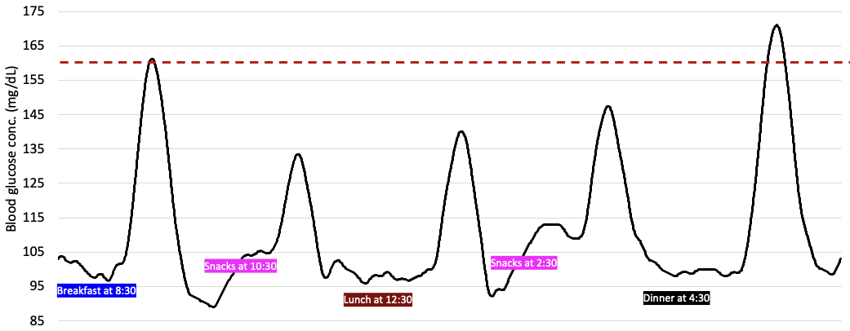
Project 1: Aligned RL for Behavior Change
Two thirds of deaths and majority of our annual $4.5 trillion healthcare costs are attributed to chronic conditions
75% of chronic conditions can be prevented or delayed through behavior change (e.g., changes in diet, activity)
Challenge:
Behavior change is difficult to sustain, suggesting adaptive just-in-time interventions
Behavioral theories follow a one-size-fits-all approach and thus do not provide personalized decision policies for just-in-time adaptive intervention.
frequent exposure to glucose spikes (i.e., hyperglycemia) increases risk of cardiovascular disease, diabetes, cancer, and stroke.

Slide 5
Project 1: Aligned RL for Behavior Change (Cont’d)
Approach:
Reinforcement learning as a general framework for lasting behavior change
Alignment: Goal Setting Theory suggests that actions should align with user's goal
Incremental change: Social Cognitive Theory emphasizes monitoring and small changes as being important for lasting behavior change
Tasks
Design a reward function representation that can express various users' preferences
Design algorithms for inferring user's reward function from implicit and explicit feedback
System evaluation using historical clinical data as well as in a new user study

Slide 6
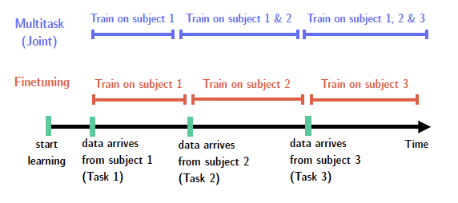
Project 2: Pervasive Continual Learning
System performance declines as it learns new tasks (e.g., data with new subjects, sensor platforms, or over time)
Task 1
Task 2
…
Task i
Task 1
Task 2
…
Task i
Design continual learning solutions for pervasive systems by
Studying distribution shifts in pervasive systems and developing methods for out-of-distribution generalization
Designing algorithms for continual learning in federated settings
Developing benchmarks to study and evaluate continual learning in pervasive systems.

Slide 7
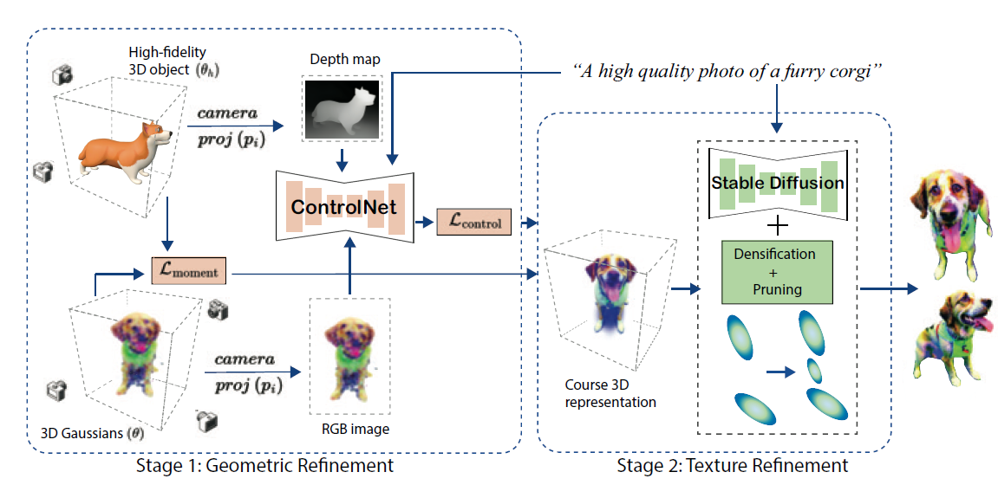
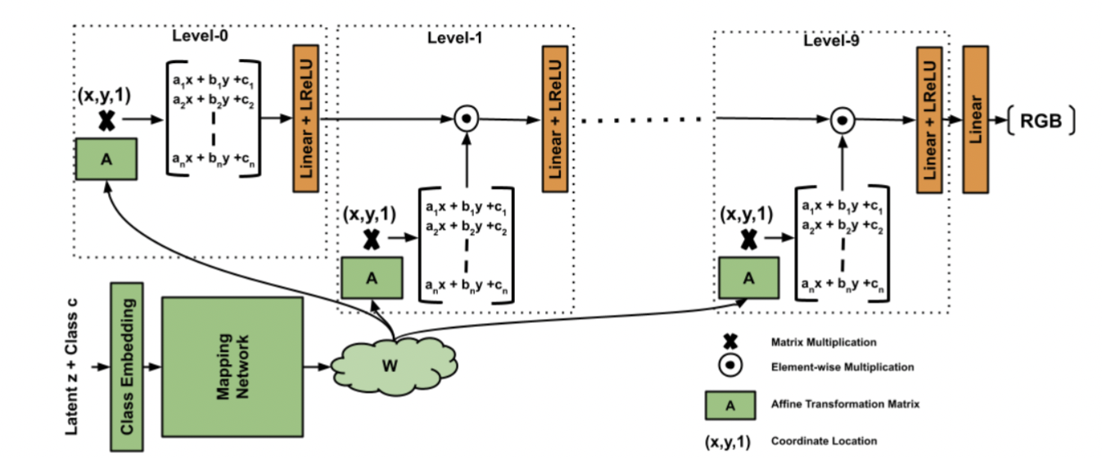
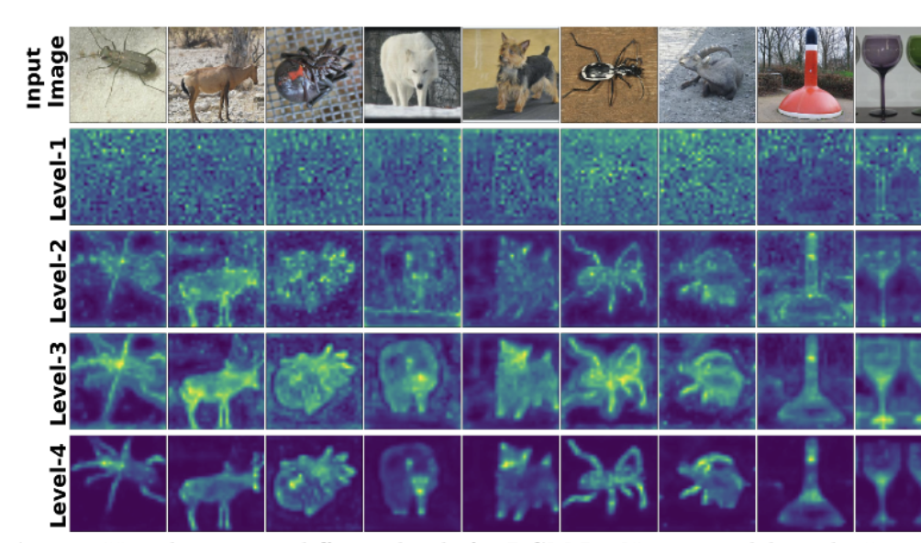
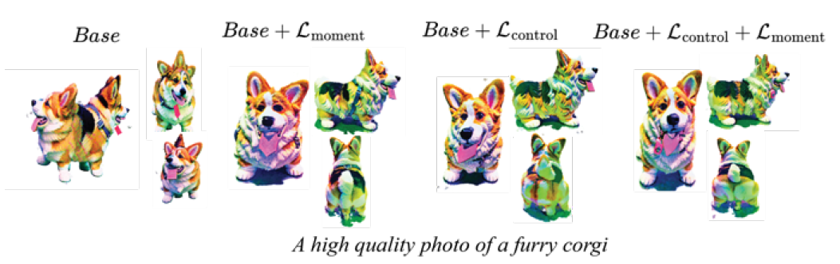
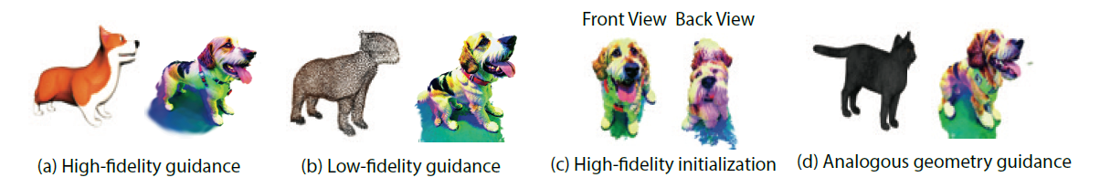
Project 3: Robust Robot Perception & Decision-Making
Novel architectures that promote shape awareness for GenAI and perceptual robotics

Slide 8

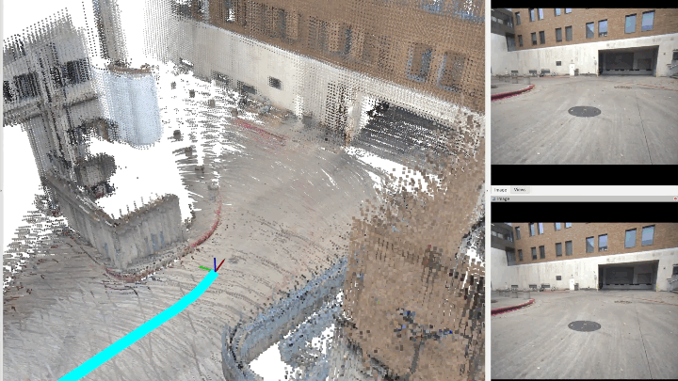

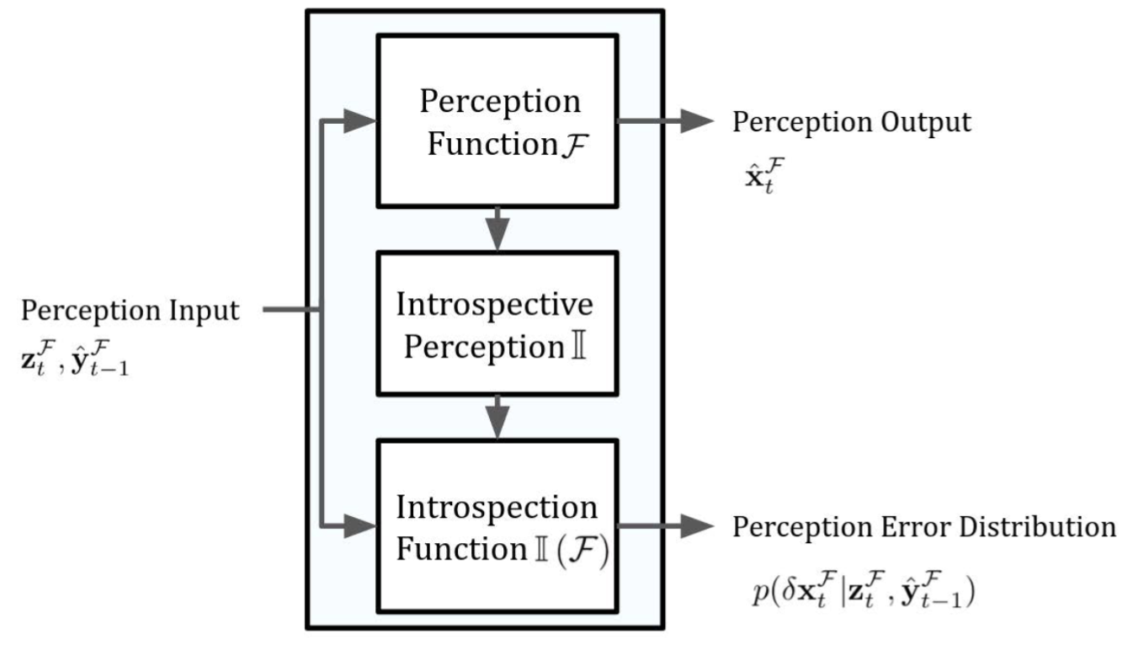

Project 3: Robust Robot Perception & Decision-Making (Cont’d)
Integrating shape awareness for robotic perception
Urban robotics CoDA
Shape control model
Car made of sushi
Car made of cheese

Slide 9
Roadmap

Slide 10
How this project incorporates foundational work
Advances ML foundations in
Foundation model for shape-aware perception
Continual learning under distribution shift
Continual federated learning
User-centered RL design

Slide 11
How this project is collaborative
Bringing together researchers from various institutions, colleges, schools, departments, and backgrounds
Shared tasks: All tasks were jointly developed by investigators from both institutions collaboratively

Slide 12
How this project is collaborative
ASU team has strong internal collaborations within the team and a large network of additional experts built over previous team grants (NSF PIPP Phase I, DARPA AI-E Geometries of Learning, NSF IN2WIBE, DMS-NIGMS, NSF CPS) who can be leveraged for increased impact.
Existing collaborations with Mayo Clinic Arizona, clinical experts in the College of Health Solutions
New collaborative opportunities exist with the newly founded ASU School of Medicine and Advanced Medical Engineering
We will bring these collaborative networks to UT-Austin team members and the larger IFML community.

Slide 13
Thank You!

